Slide 1
Introduction to Statistical Methods
ISM Team

Slide 2


Session 11
(18th July 2026)
Correlation and Regression

Slide 3
Example 1
Suppose you define your "getting ready time" as the time (rounded to the nearest minute) from when you get out of bed until you leave your home. You collect the following times over 10 consecutive workdays:
Day | 1 | 2 | 3 | 4 | 5 | 6 | 7 | 8 | 9 | 10
Time (min) | 39 | 29 | 43 | 52 | 39 | 44 | 40 | 31 | 44 | 35
How do you summarize the above data?

Slide 4
Example 2
The owner of a Showtime movie theatre wishes to predict weekly gross revenue based on advertising expenditures. The sample data are as follows:
Sl. No | 1 | 2 | 3 | 4 | 5 | 6 | 7 | 8
Weekly gross revenue (‘1000s) | 96 | 90 | 95 | 92 | 95 | 94 | 94 | 94
Television advertising (‘1000s) | 5.0 | 2.0 | 4.0 | 2.5 | 3.0 | 3.5 | 2.5 | 3.0
Newspaper advertising (‘1000s) | 1.5 | 2.0 | 1.5 | 2.5 | 3.3 | 2.3 | 4.2 | 2.5
Is summarization of the above data enough? Or do we need to look beyond just summerization?

Slide 5
In example 1, as the data relates to a single variable, only summarization with descriptive statistics is enough. But in example 2, as there are three variables, besides summarization by descriptive statistics, it is also required to find out whether, there is relation between the variables.
In summary statistics, one important measure besides mean is variance (or standard deviation)

Slide 6
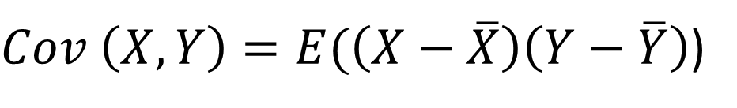
Covariance
Likewise, in the pursuit of finding the relation between two or more variables, the statistical technique used for studying the existence and extent of relationship between the variables is through Covariance
Covariance indicates the direction of the linear relationship between two variables. By direction, we mean whether the variables tend to increase together (positive relationship) or whether one tends to increase as the other decreases (negative relationship).
$Cov \left(X, Y\right)=E(\left(X−\overline{X}\right)\left(Y−\overline{Y}\right)$)

Slide 7
Covariance
The value of covariance can be any real number, ranging from negative infinity to positive infinity. It is also important to note that covariance measures only how two variables vary together; it does not measure the degree of dependence or the strength of the relationship between them.
The upper and lower limits of covariance depend on the variances of the variables involved. These variances, in turn, depend on the scales of the variables. Even a change in the units of measurement can alter the covariance. Therefore, covariance is useful for determining only the direction of the linear relationship between two variables, not its strength or magnitude.

Slide 8
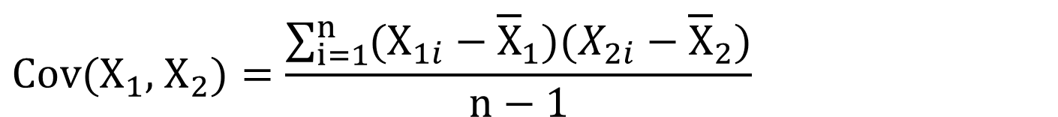
Covariance
If X₁ and X₂ are two variables, the covariance between X₁ and X₂ is defined as
$$\text{Cov}(X_{1}\text{, }{\text{X}}_{2})=\frac{\sum_{i=1}^{n}{(X_{1i}−{\overline{X}}_{1})(X_{2i}−{\overline{X}}_{2})}}{n−1}$$
Although covariance indicates the direction of the linear relationship between two variables, its magnitude is difficult to interpret because it depends on the units of measurement of the variables. If the variables are measured in different units, the numerical value of the covariance changes accordingly. Therefore, the sign of the covariance indicates whether the variables tend to move in the same direction (positive covariance) or in opposite directions (negative covariance), but the magnitude of the covariance does not provide a meaningful measure of the strength of their relationship.

Slide 9





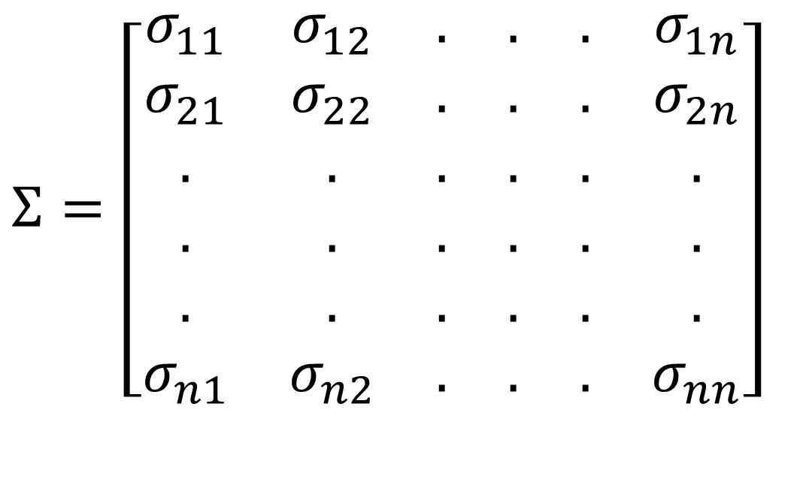




Covariance
If X₁, X₂, …, X_{n} are n variables, then the Covariance among these n variables is the Variance – Covariance matrix, given by
$$Σ=\left[\begin{matrix}σ_{11} & σ_{12} & . & . & . & σ_{1n} \\ σ_{21} & σ_{22} & . & . & . & σ_{2n} \\ . & . & . & . & . & . \\ . & . & . & . & . & . \\ . & . & . & . & . & . \\ σ_{n1} & σ_{n2} & . & . & . & σ_{nn}\end{matrix}\right]$$
All diagonal elements in the variance-covariance matrix are variances and off diagonal elements are covariances.
Σ is a symmetric matrix.

Slide 10














Covariance
Example: Find the covariance between age (years) and weight (kgs) for the following data
8 | 8 | 10 | 7 | 4 | 5 | Age (years)
25 | 26 | 32 | 23 | 18 | 20 | Weight (kgs)

Slide 11












Covariance
Age (yrs) (X) | Weight (kgs) (Y)
5 | 20 | -2 | -3 | 6
4 | 18 | -3 | -5 | 15
7 | 23 | 0 | 0 | 0
10 | 32 | 3 | 9 | 27
8 | 26 | 1 | 3 | 3
8 | 25 | 1 | 2 | 2
$$\sum{Y}=144$$

Slide 12

Covariance
Covariance based on Probability distribution.
If X and Y are two random variables with probability mass function p(x) or probability density function f(x), then the covariance between X and Y
Cov (X, Y) = E[(X-µ_{X})(Y-µ_{Y})] = E(XY) – E(X)E(Y)
where E(X) = µ_{X} and E(Y) = µ_{Y} are the means of X and Y.

Slide 13












Covariance
Application of Covariance.
1. Multivariate linear regression:
If there is a dependent variable and n independent variables, to find out the relationship between these (n+1) variables, a variance – covariance matrix will be helpful.
2. Time series:
In the given series of data over time, it helps in finding the autocorrelation at different time lags.
For example, if X_{t1}, X_{t2}, . . . , X_{tn} denote the time series data over a given period, then the autocovariance at lag h is given by γ_{X}(t+h, t) = Cov (X_{t+h}, X_{t})

Slide 14
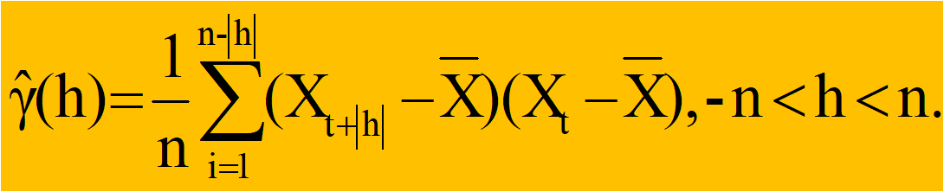
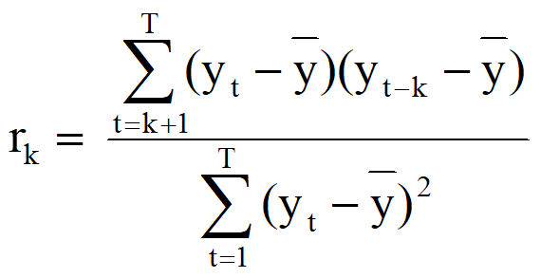
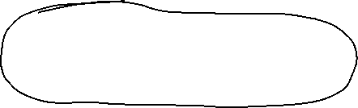
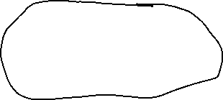
Covariance
For example, if X_{t1}, X_{t2}, . . . , X_{tn} denote the time series data over a given period, then the auto-covariance at lag h is given by
With the help of auto-covariance, the autocorrelation is given by

Slide 15
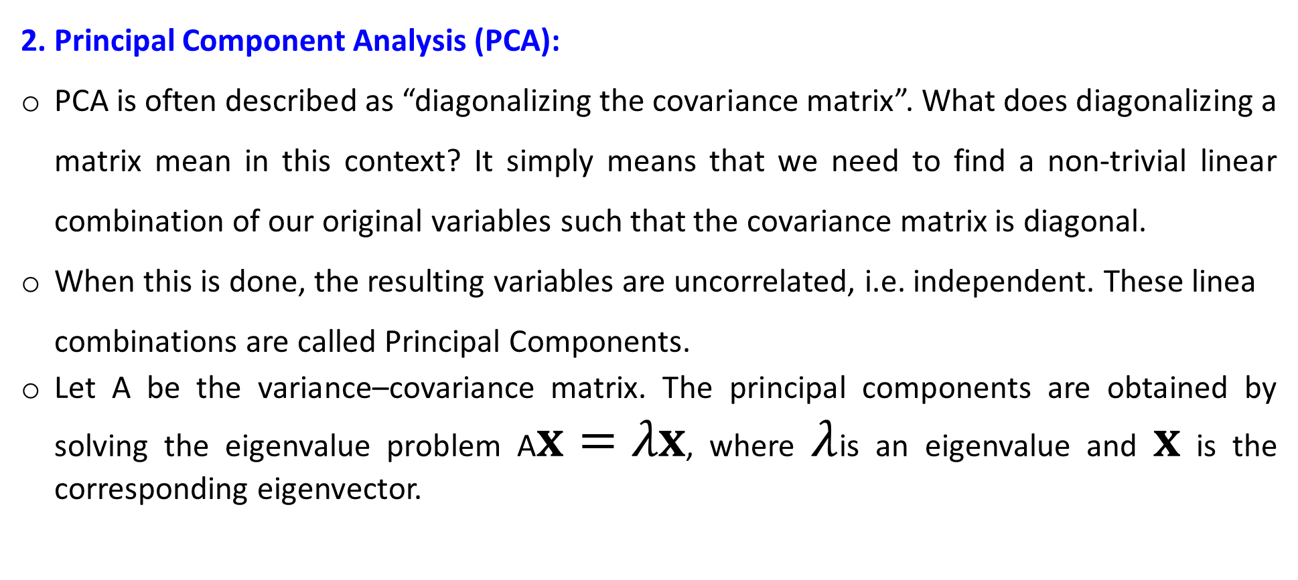


Application of Covariance
2. Principal Component Analysis (PCA):
PCA is often described as “diagonalizing the covariance matrix”. What does diagonalizing a matrix mean in this context? It simply means that we need to find a non-trivial linear combination of our original variables such that the covariance matrix is diagonal.
When this is done, the resulting variables are uncorrelated, i.e. independent. These linea combinations are called Principal Components.
Let A be the variance–covariance matrix. The principal components are obtained by solving the eigenvalue problem A$x=λx$, where $λ$is an eigenvalue and $x$ is the corresponding eigenvector.

Slide 16
Application of Covariance
Calculate the eigenvalues and the corresponding eigenvectors of the covariance of the matrix A. If an eigenvalue computed in PCA is large, then the corresponding eigenvector (principal component) is important in describing the underlying data dependencies.
If the eigenvalue is near zero, that principal component is relatively unimportant and the data depend primarily on fewer components than there are measurement types. We merely need the machinery of eigenvectors and covariance matrices in order to find linear combinations of our original variables that are uncorrelated.

Slide 17
Correlation coefficient
To overcome the issue related to Covariance, Karl Pearson’s suggestion was to divide the covariance of the variables by their respective standard deviations. The ratio of covariance to the product of standard deviations is called Karl Pearson’s product moment correlation, which is free of unit of measurement.
Karl Pearson’s product moment correlation returns a numerical value, popularly known as Coefficient of Correlation, denoted by ‘r’
Correlation coefficient is a statistic that assesses the strength and direction of relationship of two continuous variables

Slide 18
Correlation coefficient
Mathematically the following measures are used to find out the degree of relationship between the variables
♦ Karl Pearson’s product moment correlation
♦ Spearman’s rank correlation
The numerical value obtained by the above methods is called correlation coefficient
Karl Pearson’s product moment correlation or product moment correlation is also called simple correlation coefficient, denoted by ‘r’
It measures the nature and strength of relationship between two variables of the quantitative type

Slide 19
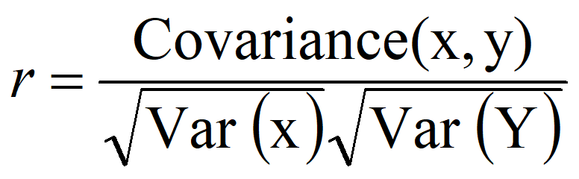
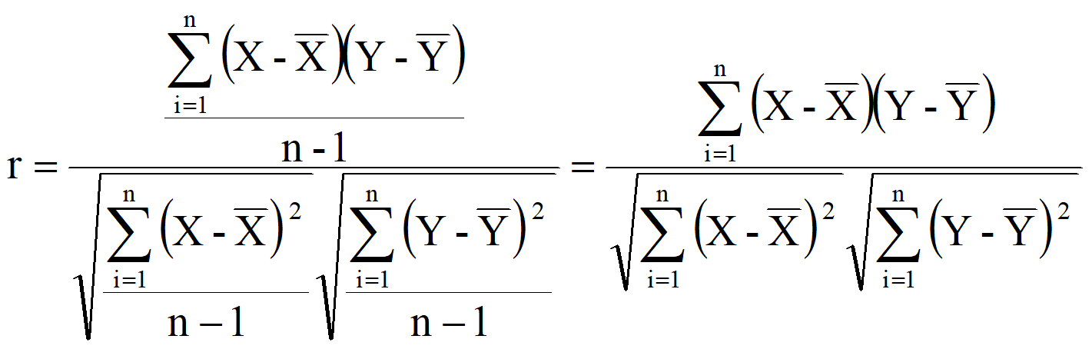
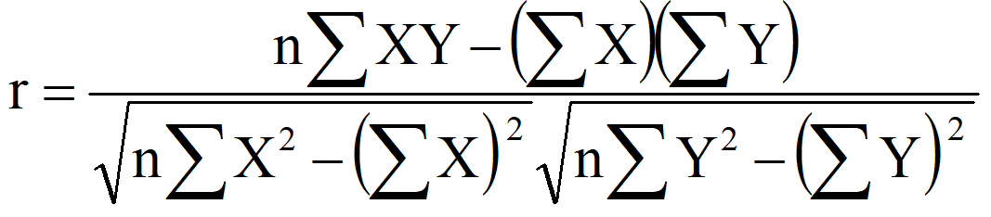


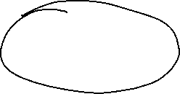
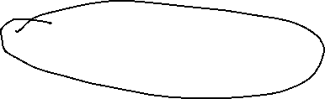


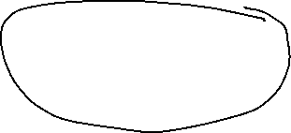
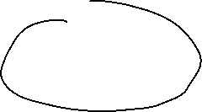









Karl Pearson’s Correlation coefficient
Formula for computing Karl Pearson’s correlation coefficient (r) is standardised covariance (unit less)

Slide 20
Karl Pearson’s Correlation coefficient
The sign of ‘r’ denotes the nature of relationship
The value of ‘r’ denotes the strength of relationship.
If the sign is +ve, this means the relation is direct (an increase in one variable is associated with an increase in the other variable and a decrease in one variable is related with a decrease in the other variable).
If the sign is -ve this means an inverse or indirect relationship (an increase in one variable is related with a decrease in the other).
The value of r ranges between ( -1) and ( +1), i.e., -1 ≤ r ≤ +1
The value of r denotes the strength of the relationship as illustrated by the following diagram.

Slide 21
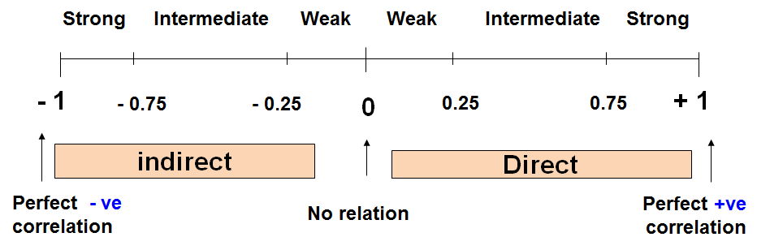
Karl Pearson’s Correlation coefficient

Slide 22
Karl Pearson’s Correlation coefficient
r = - 1 ⇒ Perfect negative correlation
- 0.99 to - 0.76 ⇒ Strong negative correlation
- 0.75 to - 0.26 ⇒ Intermediate (Moderate) negative correlation
- 0.25 to 0 ⇒ Weak negative correlation
r = 0 ⇒ Zero correlation
0 to 0.25 ⇒ Weak positive correlation
0.26 to 0.75 ⇒ Intermediate (Moderate) positive correlation
0.76 to 0.99 ⇒ Strong positive correlation
r = + 1 ⇒ Perfect positive correlation

Slide 23
Karl Pearson’s Correlation coefficient
Weight (Kg) | Age (yrs) | Serial No
12 | 7 | 1
8 | 6 | 2
12 | 8 | 3
10 | 5 | 4
11 | 6 | 5
13 | 9 | 6

Slide 24
Karl Pearson’s Correlation coefficient
Y² | X² | XY | Wt (Kg) (Y) | Age (yrs) (X) | Sl no.
144 | 49 | 84 | 12 | 7 | 1
64 | 36 | 48 | 8 | 6 | 2
144 | 64 | 96 | 12 | 8 | 3
100 | 25 | 50 | 10 | 5 | 4
121 | 36 | 66 | 11 | 6 | 5
169 | 81 | 117 | 13 | 9 | 6
∑Y²= 742 | ∑X²= 291 | ∑XY= 461 | ∑Y=66 | ∑X=41 | Total

Slide 25
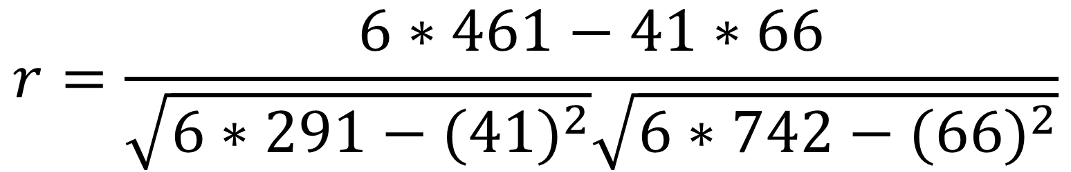
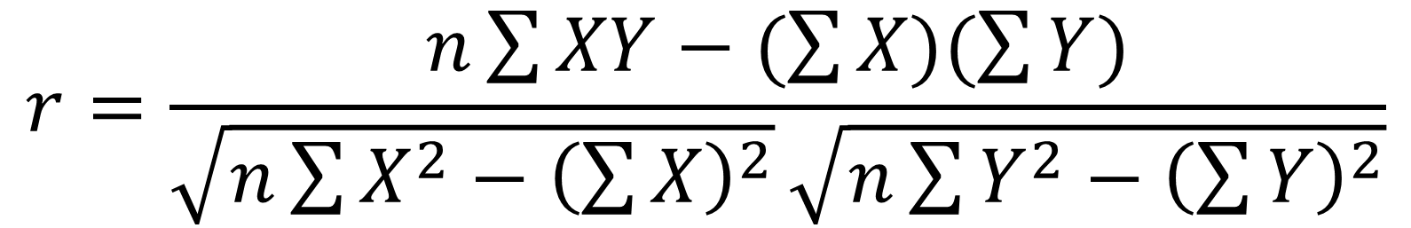
Karl Pearson’s Correlation coefficient
$$r=\frac{n\sum{XY−(\sum{X)(\sum{Y)}}}}{\sqrt{n\sum{X^{2}−{\left(\sum{X}\right)}^{2}}}\sqrt{n\sum{Y^{2}−{\left(\sum{Y}\right)}^{2}}}}$$
$$r=\frac{6∗461−41∗66}{\sqrt{6∗291−({41)}^{2}}\sqrt{6∗742−({66)}^{2}}}$$
r = 0.759 (Positive (Direct) strong correlation)

Slide 26
Karl Pearson’s Correlation coefficient
Example: Relationship between anxiety and test Scores
Anxiety (X) | Test score (Y) | X² | Y² | XY
10 | 2 | 100 | 4 | 20
8 | 3 | 64 | 9 | 24
2 | 9 | 4 | 81 | 18
1 | 7 | 1 | 49 | 7
5 | 6 | 25 | 36 | 30
6 | 5 | 36 | 25 | 30
∑X = 32 | ∑Y = 32 | ∑X² = 230 | ∑Y² = 204 | ∑XY= 129

Slide 27
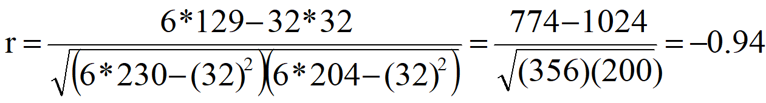
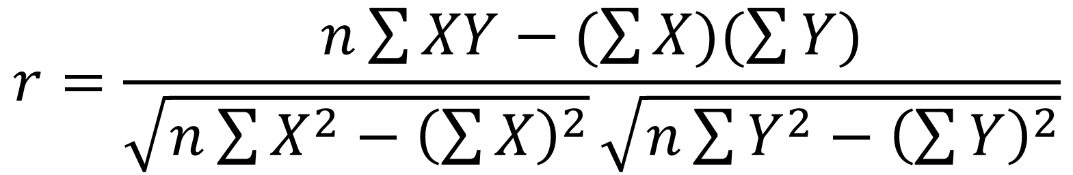
Karl Pearson’s Correlation coefficient
$$r=\frac{n\sum{XY−(\sum{X)(\sum{Y)}}}}{\sqrt{n\sum{X^{2}−{\left(\sum{X}\right)}^{2}}}\sqrt{n\sum{Y^{2}−{\left(\sum{Y}\right)}^{2}}}}$$
r = - 0.94 (Negative (Indirect) strong correlation )

Slide 28
Fig 1: Perfect negative correlation: r = – 1
Y
X

Slide 29

Fig 2: Strong negative correlation: – 0.99 ≤ r < – 0.75
Y
X

Slide 30
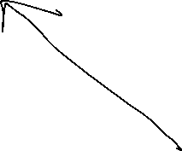
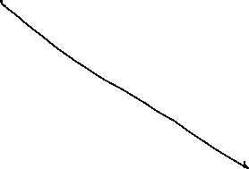





Fig 3: Moderate negative correlation: – 0.75 ≤ r < – 0.25
Y
X

Slide 31
Fig 4: Weak negative correlation: – 0.25 ≤ r < 0
Y
X

Slide 32
Fig 5 (a): Zero correlation: r = 0
Y
X

Slide 33
Fig 5 (b): Zero correlation: r = 0
Y
X

Slide 34
Fig 5 (c): Zero correlation: r = 0
Y
X

Slide 35
Fig 6: Weak positive correlation: 0 < r ≤ 0.25
Y
X

Slide 36
Fig 7: Moderate positive correlation: 0.25 < r ≤ 0.75
Y
X

Slide 37
Fig 8: Strong positive correlation: 0.75 < r ≤ 0.99
Y
X

Slide 38
Fig 9: Perfect negative correlation: r = + 1
Y
X

Slide 39
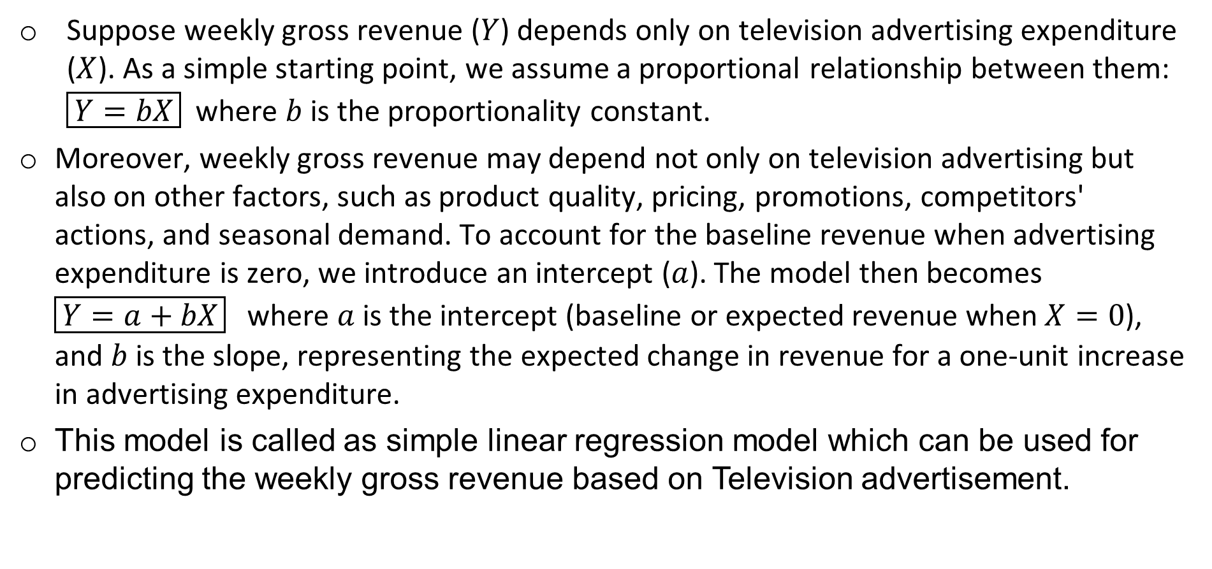


Regression Analysis
Suppose weekly gross revenue ($Y$) depends only on television advertising expenditure ($X$). As a simple starting point, we assume a proportional relationship between them: $\boxed{Y=bX}$where $b$is the proportionality constant.
Moreover, weekly gross revenue may depend not only on television advertising but also on other factors, such as product quality, pricing, promotions, competitors' actions, and seasonal demand. To account for the baseline revenue when advertising expenditure is zero, we introduce an intercept ($a$). The model then becomes $\boxed{Y=a+bX}$where $a$ is the intercept (baseline or expected revenue when $X=0$), and $b$is the slope, representing the expected change in revenue for a one-unit increase in advertising expenditure.
This model is called as simple linear regression model which can be used for predicting the weekly gross revenue based on Television advertisement.

Slide 40
Regression Analysis
While making measurements on Y and X, the possibility of error due to randomness has to be considered, thereby the full the model becomes
Y = a + bX + Ɛ
This model is called as simple linear regression model which can be used for predicting the weekly gross revenue based on Television advertisement.

Slide 41
Simple Linear Regression
Relationships:
Function: a mathematical relationship enabling us to predict what values of one variable (Y) correspond to given values of another variable (X).
Y: is referred to as the dependent variable, the response variable or the predicted variable.
X: is referred to as the independent variable, the explanatory variable or the predictor variable.

Slide 42
Simple Linear Regression
Model Assumptions about the error term Ɛ
The error Ɛ is a random variable with mean of zero.
The variance of Ɛ, denoted by σ ², is the same
for all values of the independent variable.
3. The values of Ɛ are independent.
4. The error Ɛ is a normally distributed random
variable.

Slide 43
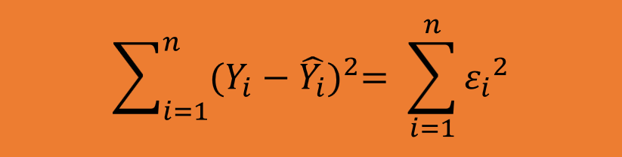
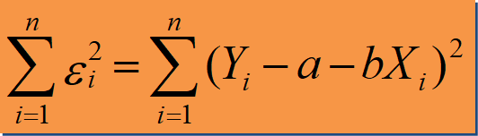
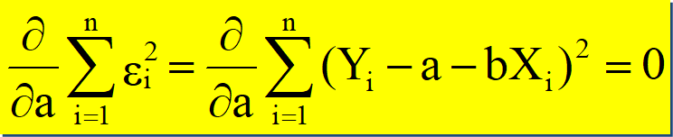
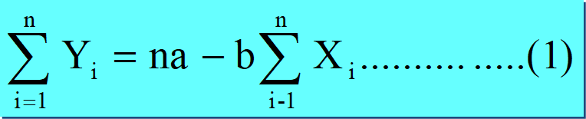
Simple Linear Regression
Least Squares
(L-S): Minimize squared error.

Slide 44
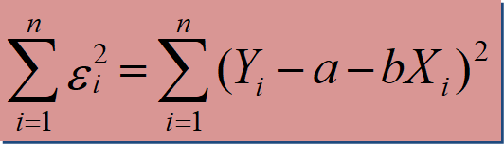
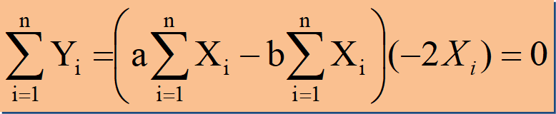



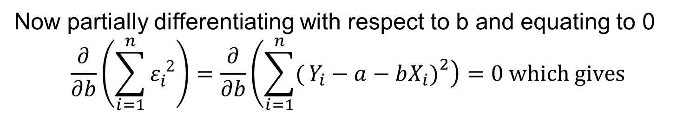
Simple Linear Regression
$$\sum_{i=1}^{n}{{(Y_{i}−\hat{Y_{i}})}^{2}= \sum_{i=1}^{n}{{ε_{i}}^{2}}}$$
Least Squares
(L-S): Minimize squared error.
Now partially differentiating with respect to b and equating to 0
$$\frac{∂}{∂b}\left(\sum_{i=1}^{n}{ε_{i}^{ 2}}\right)=\frac{∂}{∂b}\left(\sum_{i=1}^{n}{(}\left.Y_{i}−a−bX_{i}{\left.)\right.}^{2}\right)\right.=0 which gives$$

Slide 45
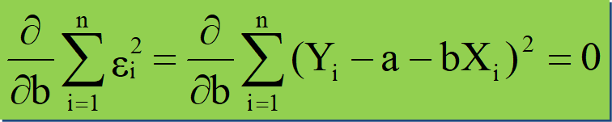
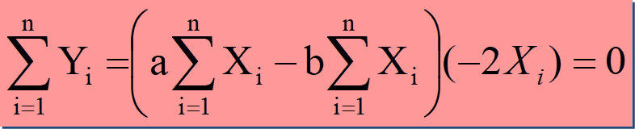
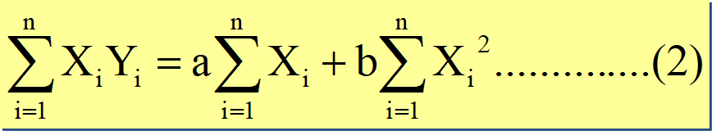
Simple Linear Regression
Equations (1) and (2) are called normal equations. Solving these as simultaneous equations, we get

Slide 46
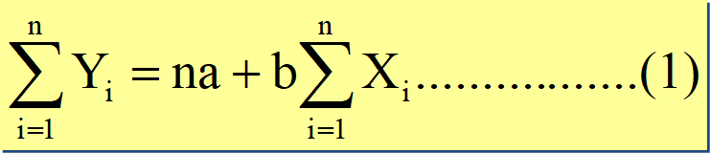
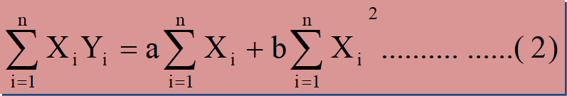
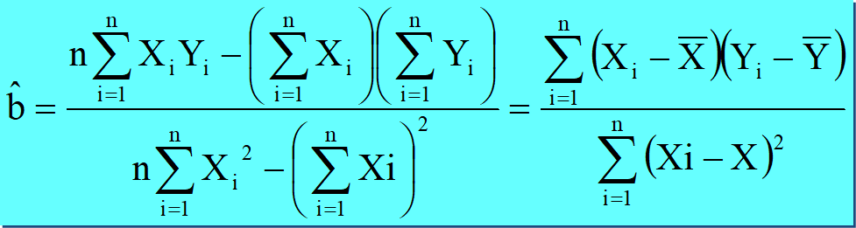
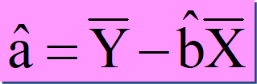
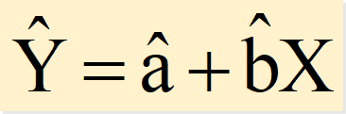




Simple Linear Regression
The fitted regression
model is

Slide 47
The owner of a showtime movie theatre wishes to predict weekly gross revenue based on advertising expenditures. The sample data are as follows:
Sl. No | 1 | 2 | 3 | 4 | 5 | 6 | 7 | 8
Weekly gross revenue (‘1000s) | 96 | 90 | 95 | 92 | 95 | 94 | 94 | 94
Television advertising (‘1000s) | 5.0 | 2.0 | 4.0 | 2.5 | 3.0 | 3.5 | 2.5 | 3.0

Slide 48


 | Weekly gross revenue ('1000s) (Y) | Television advertising ('1000s) (X) |  |  | xy | x²
 | 96 | 5.0 | 2.25 | 1.81 | 4.08 | 5.06
 | 90 | 2.0 | -3.75 | -1.19 | 4.45 | 14.06
 | 95 | 4.0 | 1.25 | 0.81 | 1.02 | 1.56
 | 92 | 2.5 | -1.75 | -0.69 | 1.20 | 3.06
 | 95 | 3.0 | 1.25 | -0.19 | -0.23 | 1.56
 | 94 | 3.5 | 0.25 | 0.31 | 0.08 | 0.06
 | 94 | 2.5 | 0.25 | -0.69 | -0.17 | 0.06
 | 94 | 3.0 | 0.25 | -0.19 | -0.05 | 0.06
Sum | 750 | 25.5 | 0 | 0 | 10.375 | 25.5
Mean | 93.75 | 3.19
$$x=(X−\overline{X})$$
$$y=(Y−\overline{Y})$$

Slide 49
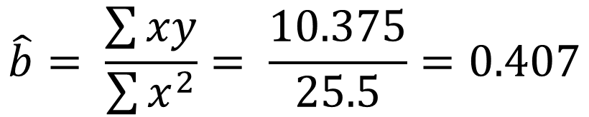
Simple Linear Regression
$$\hat{b}= \frac{\sum{xy}}{\sum{x^{2}}}= \frac{10.375}{25.5}=0.407$$
$$\hat{a}= \overline{Y}−\hat{b}∗\overline{X}=93.75 −0.407 ∗3.15=92.45$$
$$\hat{Y}=\hat{a}+\hat{b}∗X=92.45+0.407X$$
When X = 4.5,
$$\hat{Y}=92.45+0.407∗4.5=94.28$$

Slide 50
Coefficient of Determination ($r^{2}$)
So far, we have learned how to obtain the best-fit regression line using the
least squares method. But an important question still remains:
"How good is this regression line?"
Does it explain most of the variation in the data, or does it explain only a small part?
To answer this question, we partition the total variation in the response variable into two parts.

Slide 51

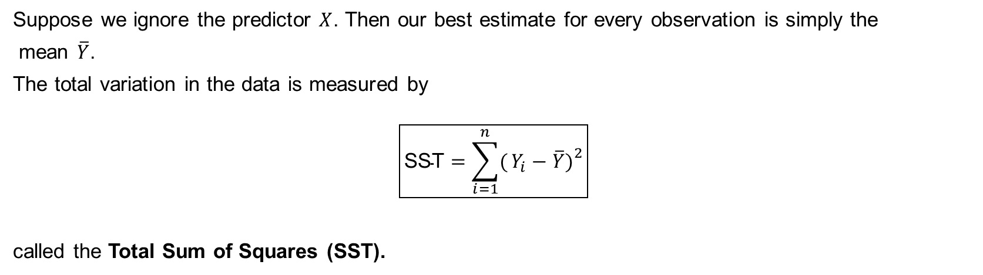




Total Sum of Squares
Suppose we ignore the predictor $X$. Then our best estimate for every observation is simply the
mean $\overline{Y}$.
The total variation in the data is measured by
$$\boxed{\text{SST}=\sum_{i=1}^{n}{(}\left.Y_{i}−\overline{Y}{\left.)\right.}^{2}\right.}$$
called the Total Sum of Squares (SST).

Slide 52
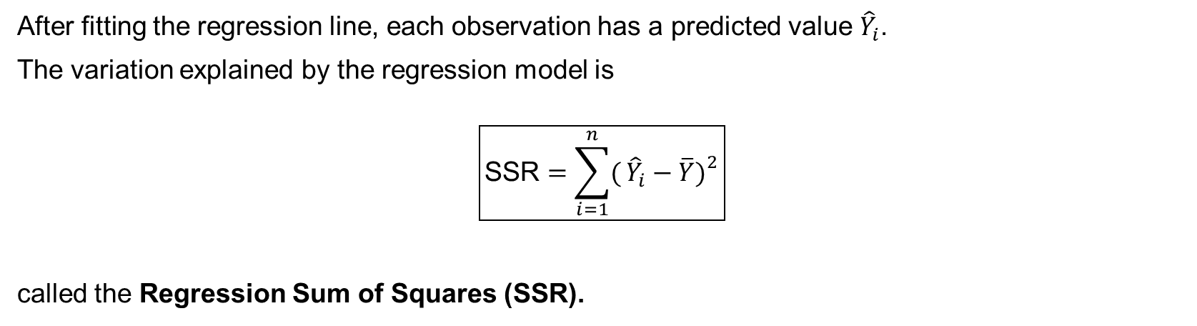
Variation Explained by Regression
After fitting the regression line, each observation has a predicted value ${\hat{Y}}_{i}$.
The variation explained by the regression model is
$$\boxed{\text{SSR}=\sum_{i=1}^{n}{(}\left.{\hat{Y}}_{i}−\overline{Y}{\left.)\right.}^{2}\right.}$$
called the Regression Sum of Squares (SSR).

Slide 53
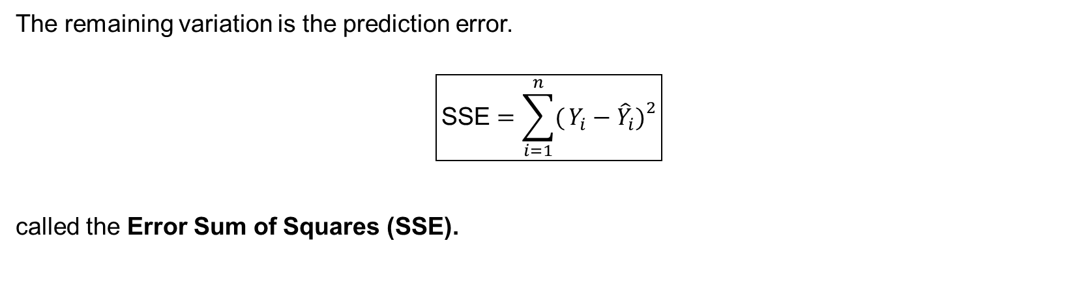







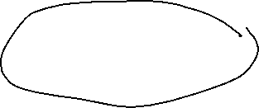
Error Sum of Squares
The remaining variation is the prediction error.
$$\boxed{\text{SSE}=\sum_{i=1}^{n}{(}\left.Y_{i}−{\hat{Y}}_{i}{\left.)\right.}^{2}\right.}$$
called the Error Sum of Squares (SSE).

Slide 54

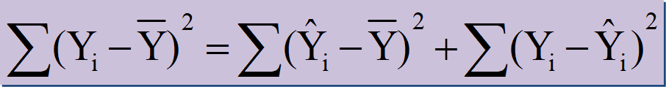



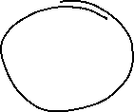
Simple Linear Regression
Coefficient of Determination
Relationship Among SST, SSR, SSE
where:
SST = Sum of Squares due to Total
SSR = Sum of Squares due to Regression
SSE = Sum of Squares due to Error

Slide 55
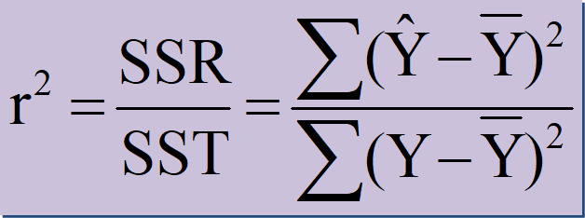
Simple Linear Regression
Coefficient of Determination
where:
SST = Sum of Squares due to Total
SSR = Sum of Squares due to Regression

Slide 56
Simple Linear Regression
Example
No. of TV advs (X) | No. of cars sold (Y)
1 | 14
3 | 24
2 | 18
1 | 17
3 | 27
2 | 20
Fit a regression line of Y on X and determine the coefficient of determination

Slide 57
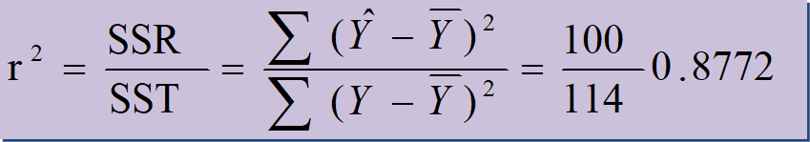

Simple Linear Regression
 | X | Y | x = (X-2) | y = (Y-20) | xy | x² | (Y-20)² | Y^ = 10 + 5X | (Y^ - 20)²
 | 1 | 14 | -1 | -6 | 6 | 1 | 36 | 15 | 25
 | 3 | 24 | 1 | 4 | 4 | 1 | 16 | 25 | 25
 | 2 | 18 | 0 | -2 | 0 | 0 | 4 | 20 | 0
 | 1 | 17 | -1 | -3 | 3 | 1 | 9 | 15 | 25
 | 3 | 27 | 1 | 7 | 7 | 1 | 49 | 25 | 25
Total | 10 | 100 | 0 | 0 | 20 | 4 | 114 |  | 100
Regression y on X
Coefficient of Determination

Slide 58
Simple Linear Regression
SL. No | X | Y | x = (X-2) | y = (Y-20) | xy | x² | (Y-20)² | Y^ = 10 + 5X | (Y^ - 20)²
1 | 1 | 14 | -1 | -6 | 6 | 1 | 36 | 15 | 25
2 | 3 | 24 | 1 | 4 | 4 | 1 | 16 | 25 | 25
3 | 2 | 18 | 0 | -2 | 0 | 0 | 4 | 20 | 0
4 | 1 | 17 | -1 | -3 | 3 | 1 | 9 | 15 | 25
5 | 3 | 27 | 1 | 7 | 7 | 1 | 49 | 25 | 25
Total | 10 | 100 | 0 | 0 | 20 | 4 | 114 |  | 100
Regression y on X
Coefficient of Determination

Slide 59
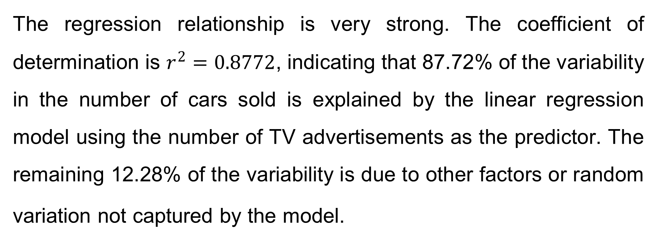
Simple Linear Regression
Interpretation
The regression relationship is very strong. The coefficient of determination is $r^{2}=0.8772$, indicating that 87.72% of the variability in the number of cars sold is explained by the linear regression model using the number of TV advertisements as the predictor. The remaining 12.28% of the variability is due to other factors or random variation not captured by the model.

Slide 60
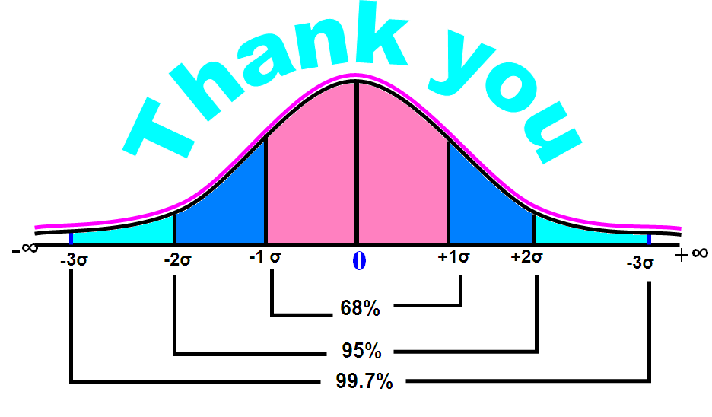
Thank You!

